Slide 1




Database Project
Group 2

Slide 2

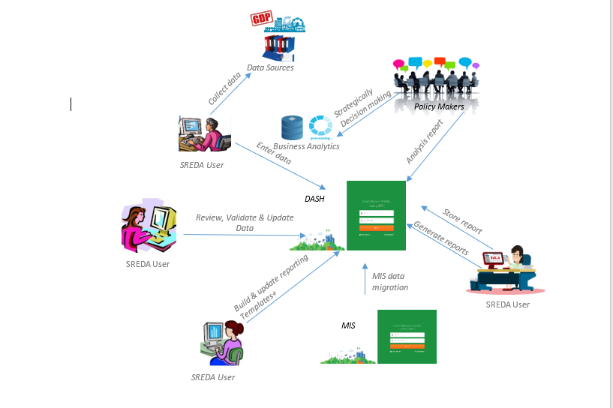
The existing system
Rich picture(AS IS)

Slide 3
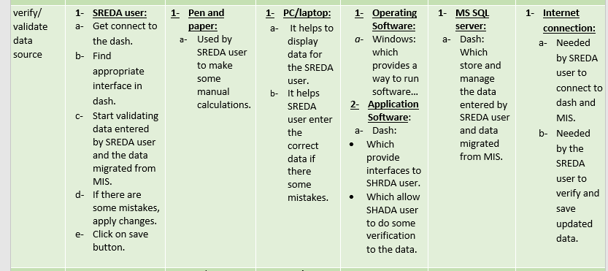
Six element analysis (As is)

Slide 4
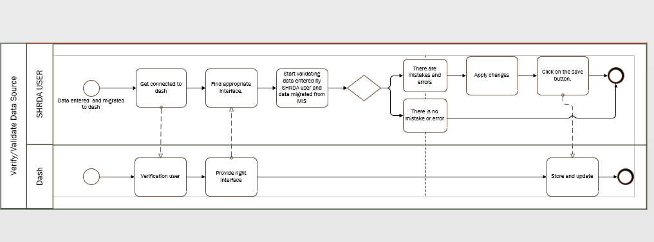
Process diagram(As is)

Slide 5
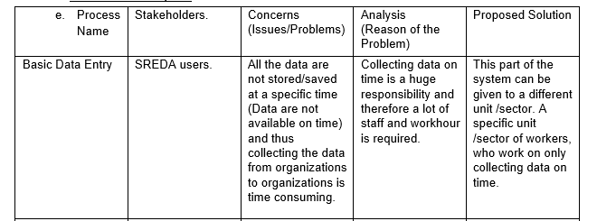
Process analysis

Slide 6
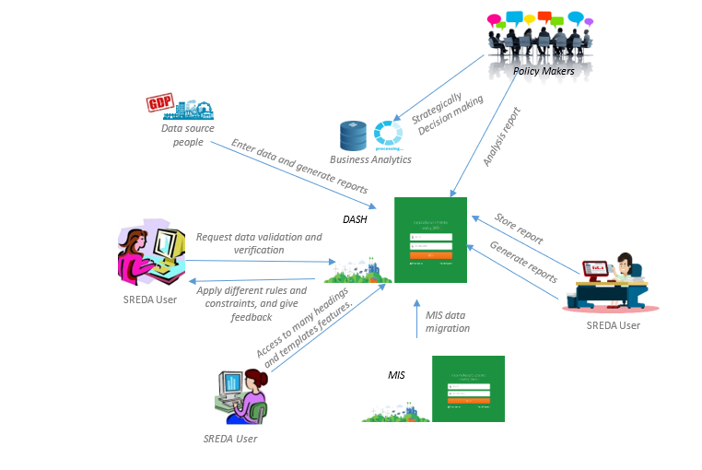
Rich Picture (TO BE)

Slide 7
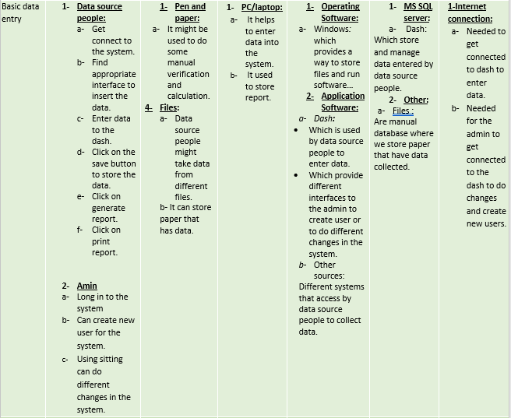
Six element analysis (TO BE):

Slide 8
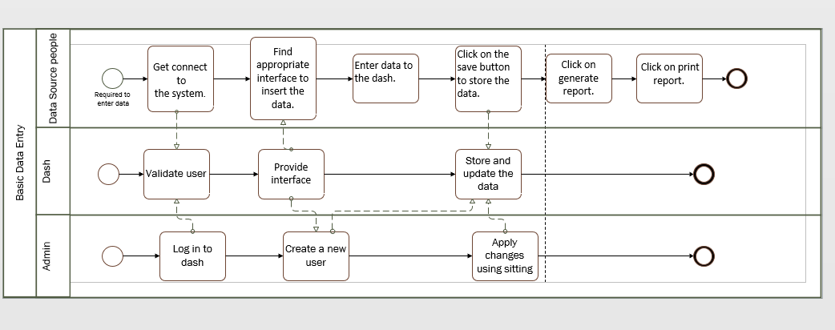
Process diagram(TO BE)

Slide 9
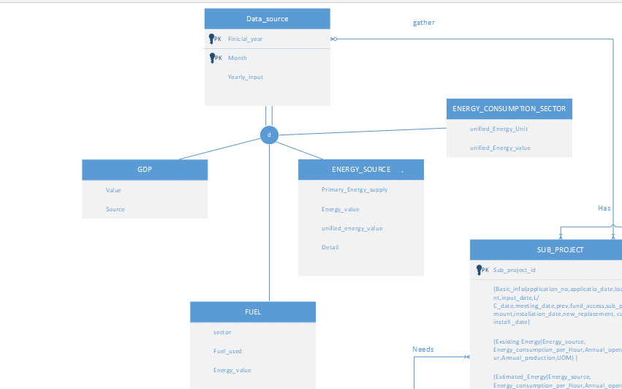
Enhanced Entity relationship

Slide 10
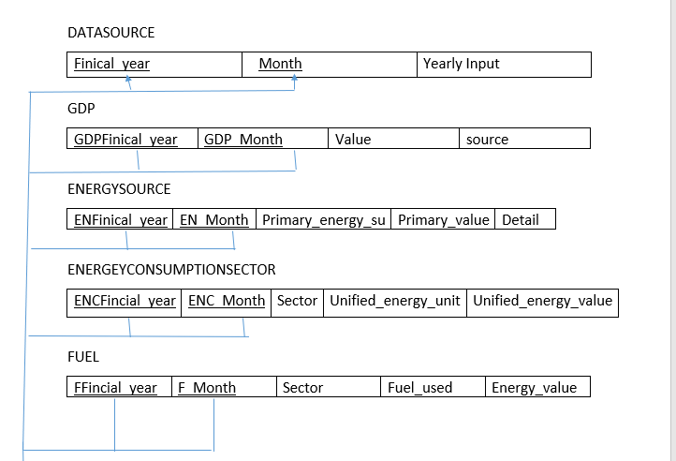
Relational schema

Slide 11
Normalization
GDPFinical_year | GDP_Month | Value | source
For first NF we found that the primary key is GDPFincial_year and GDP_Month.
There is no 2NF since there is no partial dependency.
There is no 3NF since there is no transitive dependency.
There is no BCNF.

Slide 12
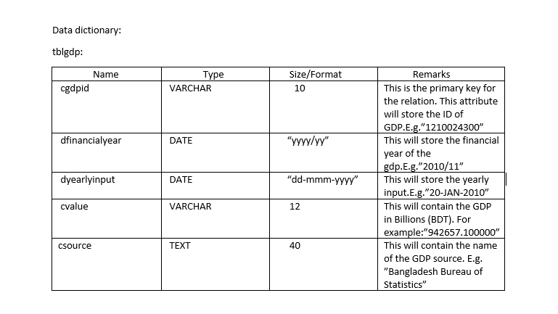
Data dictionary

Slide 13
Cout <<“Thank you ☺ << endl;

